Slide 1
Software environments organization / Software Development Life Cycle
Liubomyr Zalisko
<EPAM> LVIV UA

Slide 2
Software environment
Local
Developmen
Integration
Production/Live
Test/QA/Internal Acceptance
Stage/Pre-production/External-Client Acceptance/Demo
Environment/Tier Name | Description
Local | Developer's desktop/workstation
Development/Trunk | Development server acting as a sandbox where unit testing may be performed by the developer
Integration | CI build target, or for developer testing of side effects
Test/QA/Internal Acceptance | The environment where interface testing is performed. A quality assurance team ensures that the new code will not have any impact on the existing functionality and tests major functionalities of the system after deploying the new code in the test environment.
Model/Stage/Pre-production/External-Client Acceptance/Demo | Mirror of production environment
Production/Live | Serves end-users/clients

Slide 3
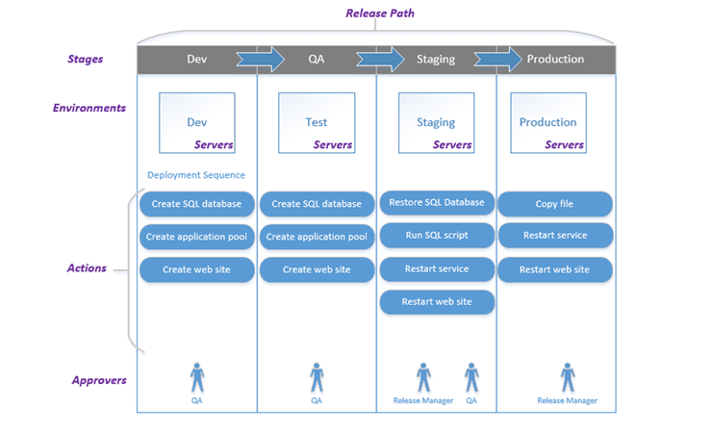
Development/Test/Integration/Staging/Production environment for Software Development

Slide 4
Development
This is the working environment for individual developers or small teams. Working in isolation with the rest of the tiers, the developer(s) can try radical changes to the code without adversely affecting the rest of the development team.
Integration/Test
A common environment where all developers commit code changes. The goal of this environment is to combine and validate the work of the entire project team so it can be tested before being promoted to the Staging Environment.
Staging
The staging tier is a environment that is as identical to the production environment as possible. The purpose of the Staging environment is to simulate as much of the Production environment as possible. The Staging environment can also double as a Demonstration/Training environment.
Production
Production environment is a term used mostly by developers to describe the setting where software and other products are actually put into operation for their intended uses by end users. A production environment can be thought of as a real-time setting where programs are run and hardware setups are installed and relied on for organization or commercial daily operations.

Slide 5
Thank you

